Slide 1
MEASURING SUCCESS IN TALENT MANAGEMENT
TEAM
R. RAGAVI
P. PAVYASRI
S. PRAVEENA
K. PRIYADHARSHINI

Slide 3
INTRODUCTION
Talent management is how employers recruit and develop a workforce that is as productive as possible and likely to stay with their organization long term. When implemented strategically, this process can help improve the overall performance of the business and ensure that it remains competitive.

Slide 4
OVERVIEW
Time-to-fill: Measures the amount of time it takes to fill an open position. ...
Cost Per Hire. Measures the cost of recruiting and hiring a new employee. ...
Employee Turnover Rate. ...
Employee Engagement. ...
Diversity and Inclusion Metrics. ...
Talent Mobility. ...
High Potential Talent.

Slide 5
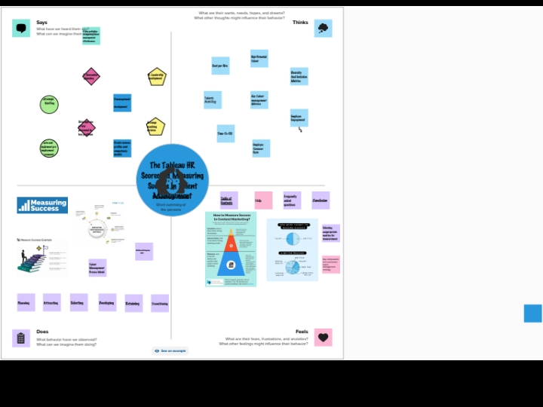
EMPATHY MAP

Slide 6
APPLICATIONS
Talent management software provides many advantages in the areas of recruitment, performance management, training and ducation, and compensation management.
employee turnover rate, time to fill job vacancies, time to productivity, employee training effectiveness, and employee engagement levels.

Slide 7

BRAINSTORMING MAP

Slide 8
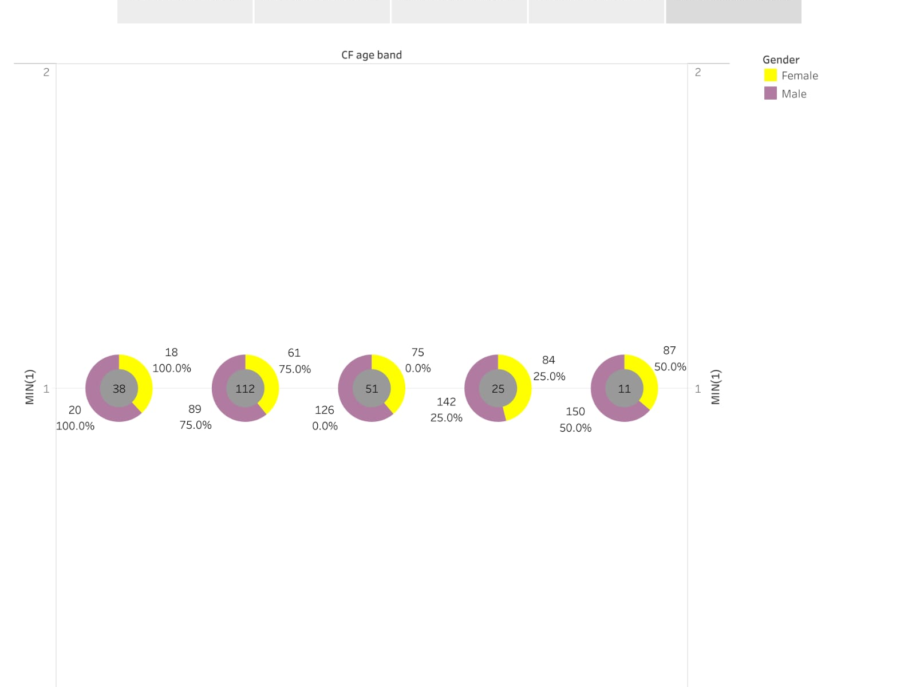
RESULT

Slide 9
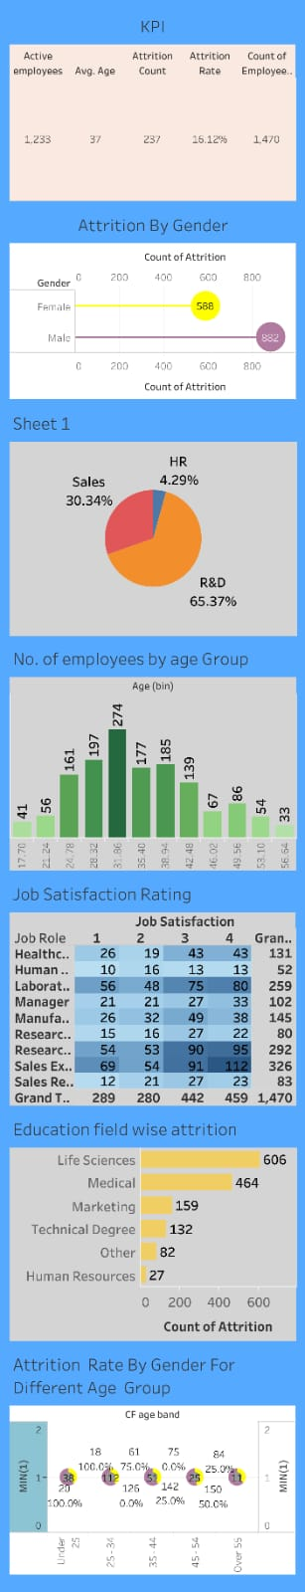

Slide 10
ADVANTAGES & DISADVANTAGES
ADVANTAGES
DISADVANTAGES
Help in ascertaining the right person is deployed in the right position.
Contributes in retaining their top talent.
Better hiring by hiring assessments
Helps in understanding employees better and shaping their future.
Promotes effective communication across different disciplines.
The implementation of talent management program could be expensive in terms of time, resources and financial costs.
Lack of support from line mangers can impede the level of commitment from employees.
A core drawback of talent management is, it can contribute in raising the conflicts between HR and management by not reaching to proper agreement or consensus.

Slide 11
CONCLUSION
At the end can say that talent management process has provide new ways to Human Resource department to handle problems faced in hiring talent. By the help of talent management process companies are hiring right person for the right job as per their job requirement and description.

